Slide 1
EEE 312 Project: Brain Tumor Detection and Segmentation from MRI ImageS.

Slide 2
Project Submitted to:
Dr. Celia Shahnaz
Professor,
Department of EEE, BUET
Arnab Bhattacharjee
Lecturer,
Department of EEE, BUET

Slide 3
Project Submitted by:
GROUP NO: 5
Sadman Sakib Ahbab ( 1306002 )
S.M.Saiduzzaman ( 1306005 )
Shakib Mahmood ( 1306009 )
Nabil Zulfiqar Zisan ( 1306020 )
Md Ashfaqur Rahman ( 1306023 )

Slide 4
Objectives……

Slide 5
There are two main objectives of our project:
1) To detect if there is a tumor in a given MRI Image
&
2) If there is, specify the location of the tumor

Slide 6
Algorithm……

Slide 7
Filtering the image using an Anisotropic diffusion Filter
Processing the image in details using morphological
operation .
Taking an MRI Image
Segmentation of the tumor in the image by a particular border
Confirmation of tumor based on density and area .
If no tumor, ending of processing image, but if there, estimating the tumor location

Slide 8
Figures of Simulation Output…..

Slide 9
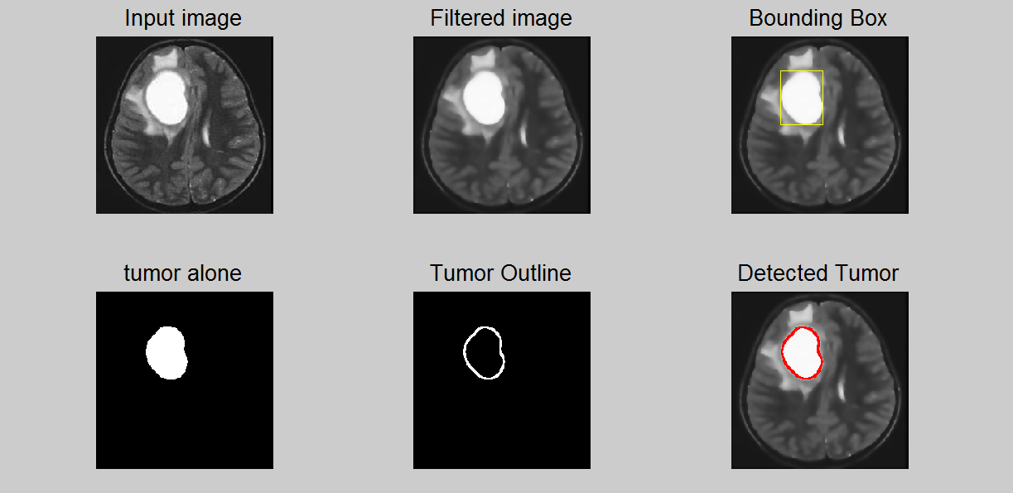
Sample 1

Slide 10
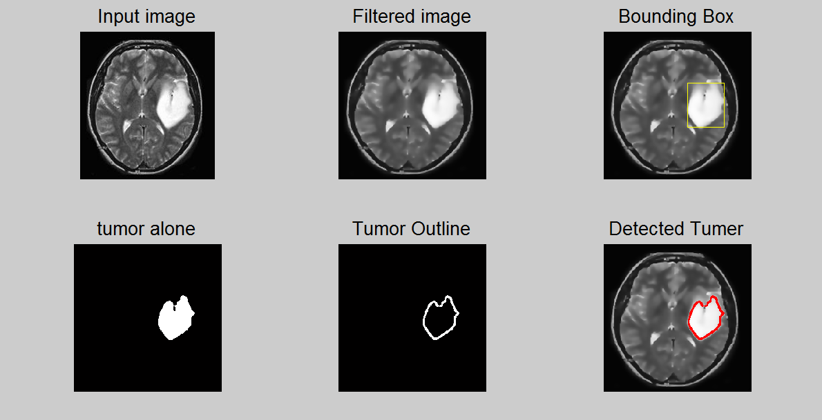
Sample 2

Slide 11
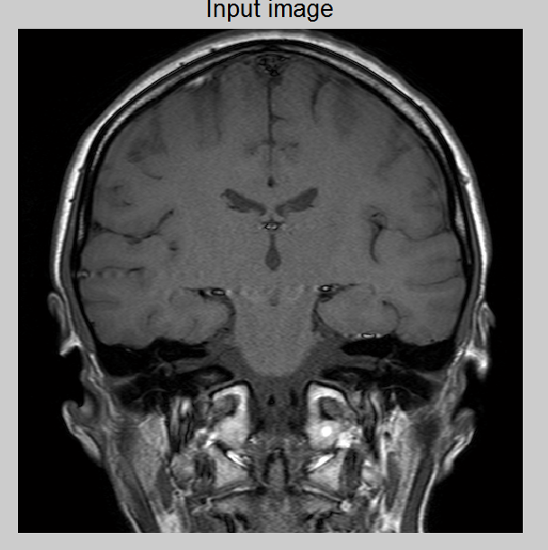
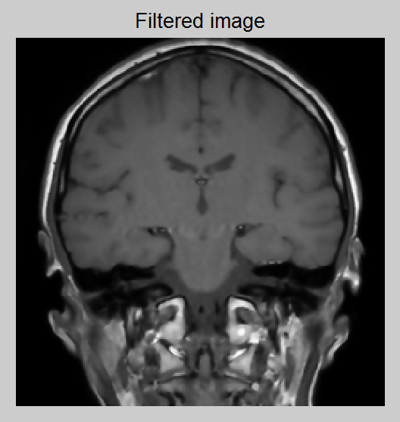
Sample 3 ( No Tumor )

Slide 12
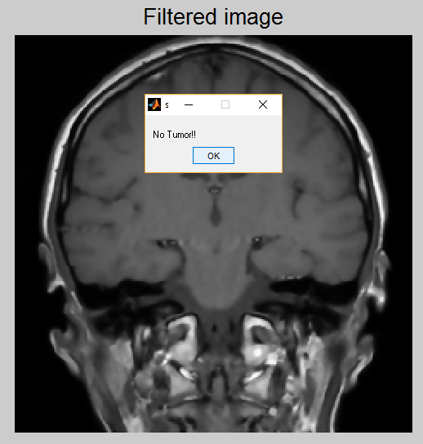

Slide 13
Challenging Detection….
Blurry & Grainy Image
Small Tumor

Slide 14
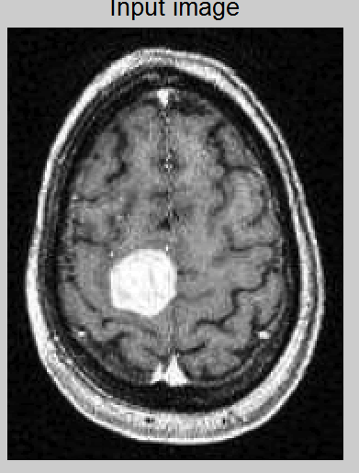
Blurry& Grainy Image…

Slide 15
Solution: Anisotropic Diffusion Filter
Shape-adapted smoothing :
it produces a family of parameterized images, but each resulting image is a combination between the original image and a filter that depends on the local content of the original image. As a consequence, anisotropic diffusion is a non-linear and space-variant transformation of the original image.
Anisoptropic Filter blurs the images without removing any edge.

Slide 16
Gaussian Convolution matrix
0 1 0 0 0 0
North = 0 -1 0 East = 0 -1 1 ………
0 0 0 0 0 0
0 0 1 1 0 0
North-East = 0 -1 0 North-west = 0 -1 0 ………
0 0 0 0 0 0

Slide 17
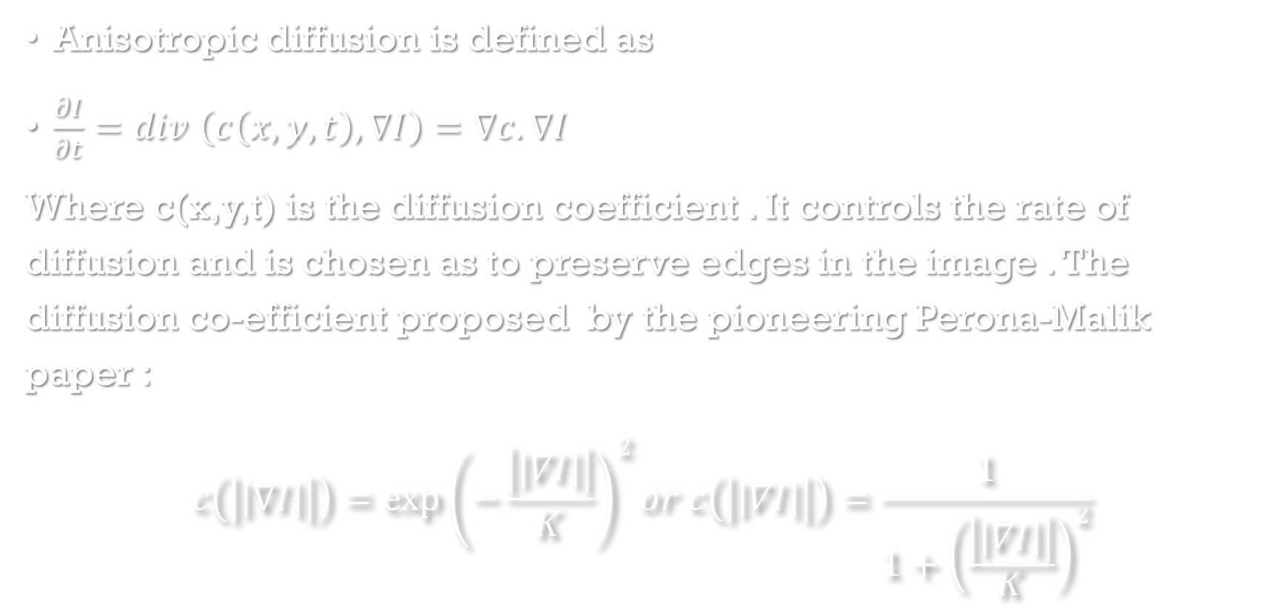
Anisotropic diffusion is defined as
$\frac{∂I}{∂t}=div \left(c\left(x,y,t\right),∇I\right)=∇c.∇I$
Where c(x,y,t) is the diffusion coefficient . It controls the rate of diffusion and is chosen as to preserve edges in the image . The diffusion co-efficient proposed by the pioneering Perona-Malik paper :
$$c\left(\left|\left|∇I\right|\right|\right)={\exp\left(−\frac{\left|\left|∇I\right|\right|}{K}\right)}^{2}or c\left(\left|\left|∇I\right|\right|\right)=\frac{1}{1+{\left(\frac{\left|\left|∇I\right|\right|}{K}\right)}^{2}}$$

Slide 18
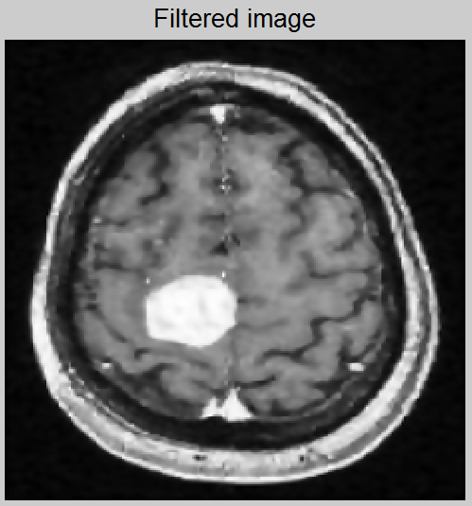

Slide 19
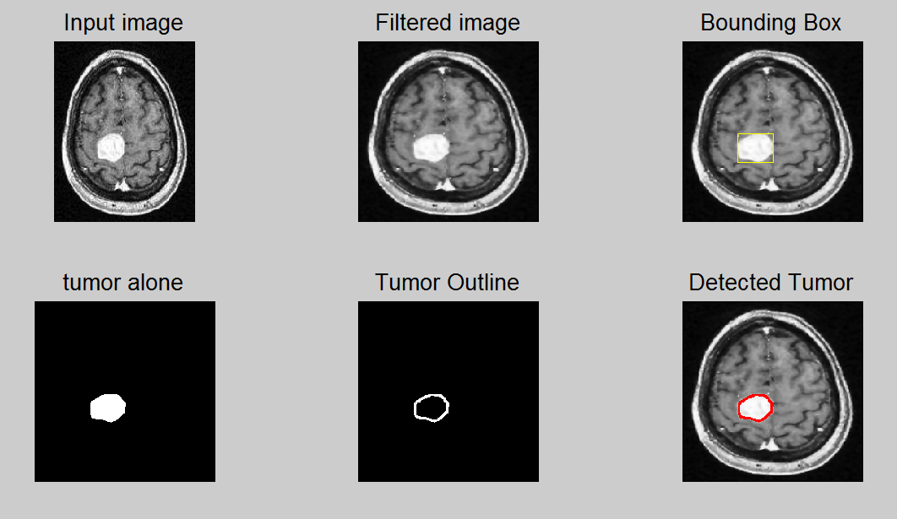

Slide 20
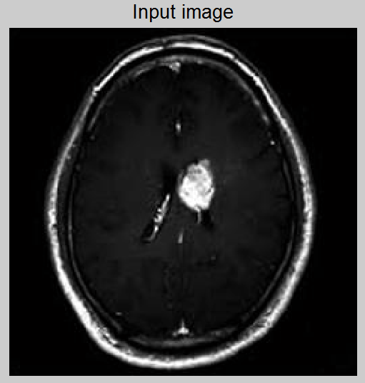
Small Tumor…

Slide 21
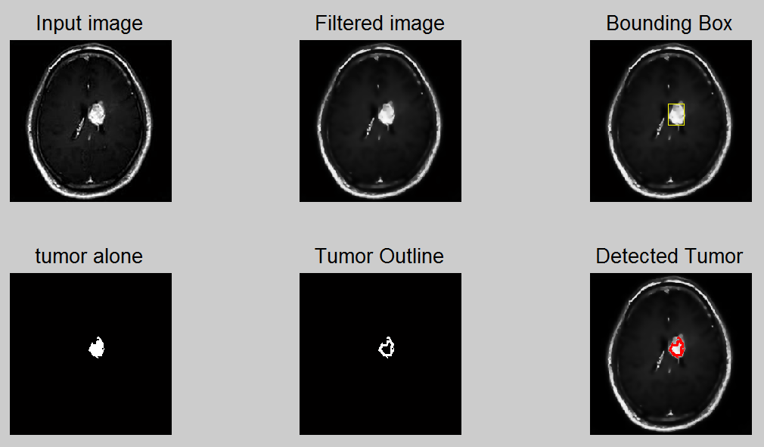

Slide 22
Detecting Tumor Border
Library functions for morphological operation were used to segment the binary image & detect the tumor area.
The Binary image was eroded, i.e, all the points in the neighborhood of a black point was turned black.
Finally we get the border by subtracting the eroded image from original binary image

Slide 23
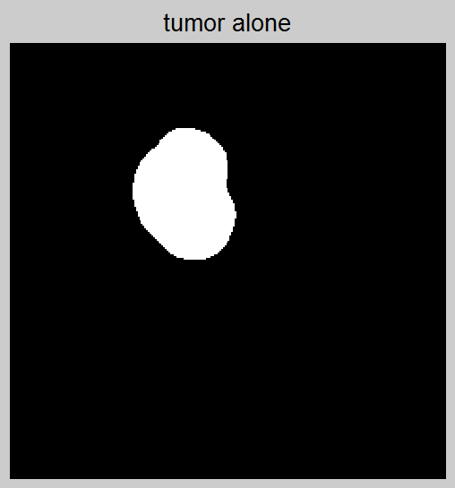
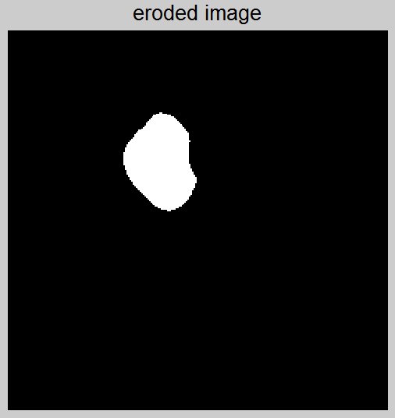
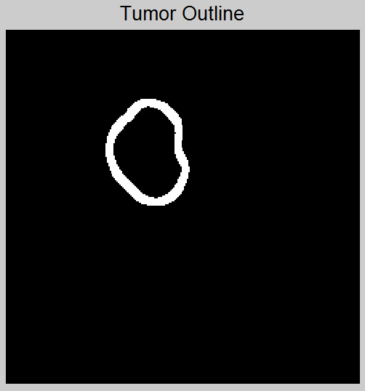

Slide 24
Short Comings…
May give false positive if the section of bones are too thick
May give false negative if the tumor image is hollow, i.e, density of tumor is low.

Slide 25
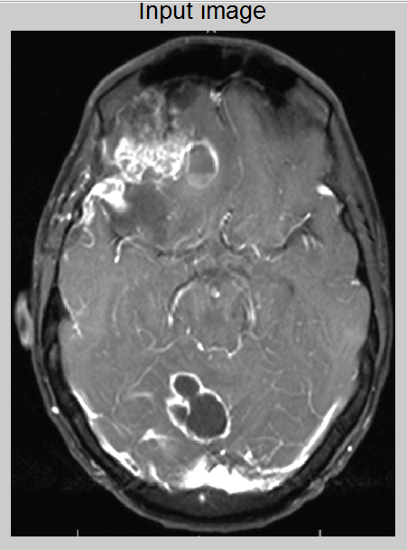
Low density tumor
Thick bone section

Slide 26
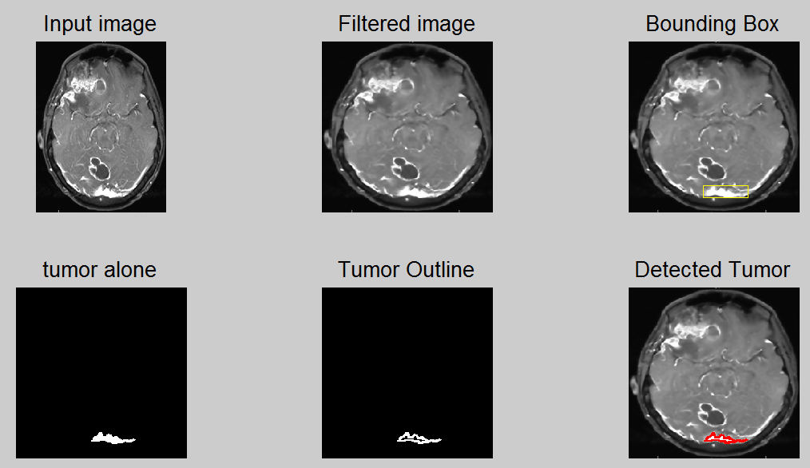

Slide 27
Scope of improvement…
The process can be extended to 3D image
The proper anatomical position may be detected
Fixed thresholds were used. Machine Learning may be implemented to train the system dynamically change the thresholds.

Slide 28
Service to the Society:
Medical image processing is the most challenging and emerging field now a days. Processing of MRI images is one of the part of this field. This code makes MRI image analysis accessible to more people who need not have to be specialist on MRI imaging.
MRI imaging is less harmful than X-ray . It is less attenuated by bones. This project can make MRI image processing and tumor detection process faster and cheaper.

Slide 29
Thanks a lot …..
Special Thanks to
Dr Ceila Shahnaz Madam and
Arnab Sir …….

